Slide 1


CoChat
(A mobile based
messaging application)
PRANKIT AGARWAL PRAKHAR AGARWAL RAHUL SAXENA AMAN VIKRANT GARG ISHITA GOEL

Slide 2


INDEX
INTRODUCTION
TECHNOLOGY USED
FLOW DIAGRAMS
SCREENSHOTS
CONCLUSION

Slide 3
INTRODUCTION

Slide 4
Why Android ?
It is an open source software.
Any phone manufacturer can use Android without
expensive license fee from Google.
The ability to run tens of thousands of app is another
big incentives.
Android is present trend and future.

Slide 5
What is Firebase ?
Firebase is Google’s mobile application development platform that helps to build an app.
Firebase provides a realtime database and backend as a service.
It provides developer an API that allows application data to be synchronized across client and stored on Firebase cloud.

Slide 6
What is CoChat ?
It is a login based messaging application.
Features
1. Messaging
2. Requests
3. Profile

Slide 7
TECHNOLOGY USED

Slide 8

FRONT END

Slide 9

BACK END

Slide 10
FLOW DIAGRAM

Slide 11
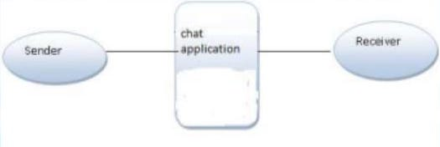
0 Level DFD
Through this DFD we are showing the basics of any contacting application. As we are seeing that a sender is sending a message using the application and the receiver is getting the message through that application.

Slide 12
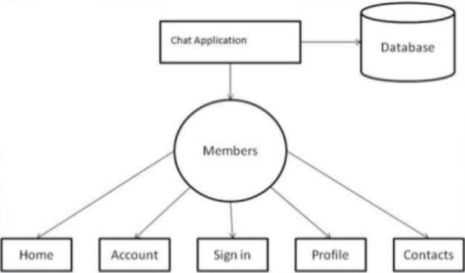
1 Level DFD

Slide 13
SCREENSHOTS

Slide 14
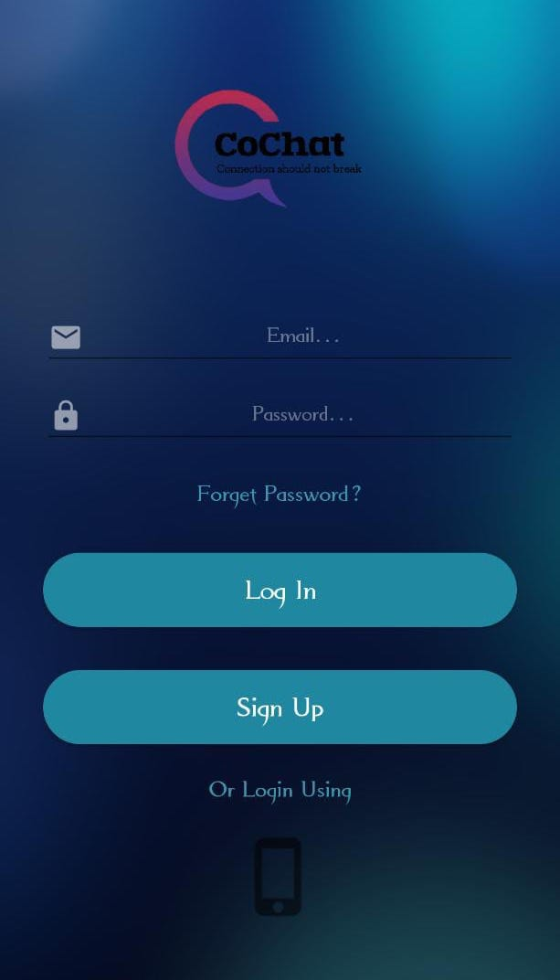
Ishita
Email
Password
move to activity for forget password
Button for Login
move to activity for create account
Button for Login from phone number
LOGIN ACTIVITY

Slide 15
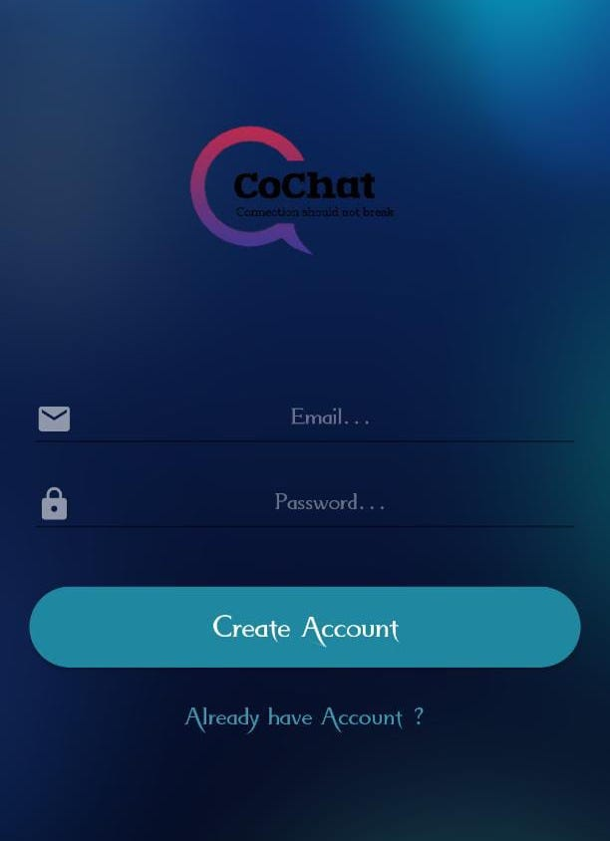
Ishita
Email
Password
Button for Create account
move to login activity
SIGN UP ACTIVITY

Slide 16
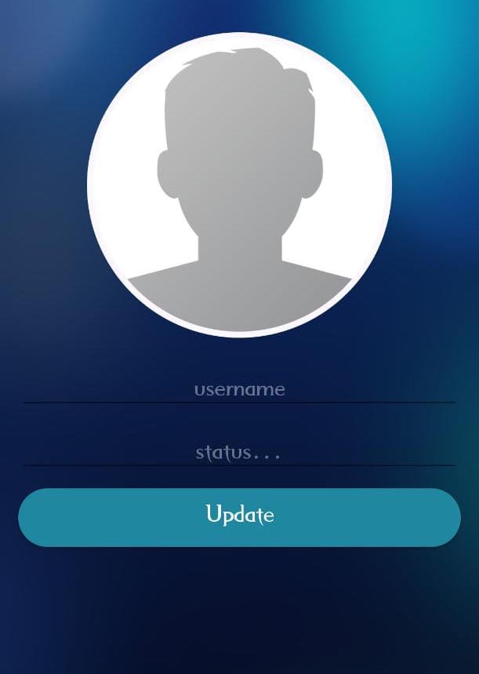
Prankit
Name
Status
Button for update profile
PROFILE ACTIVITY

Slide 17
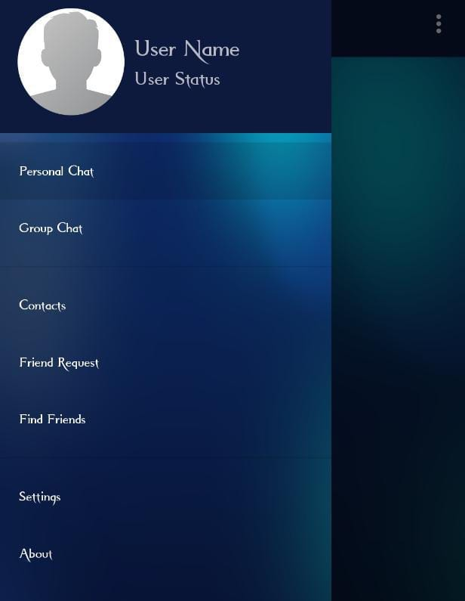
Prankit
FEATURES

Slide 18
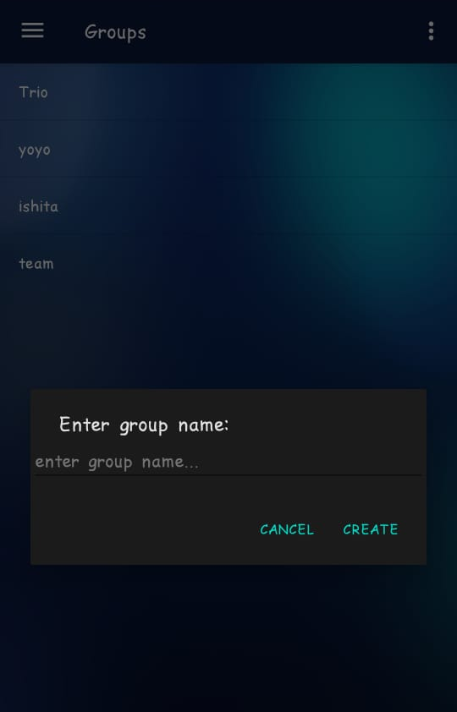
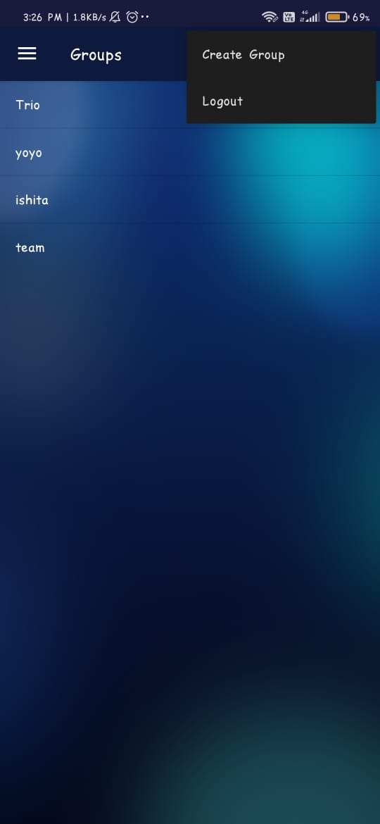
Prakhar
User display view
Group fragment
Create group

Slide 19
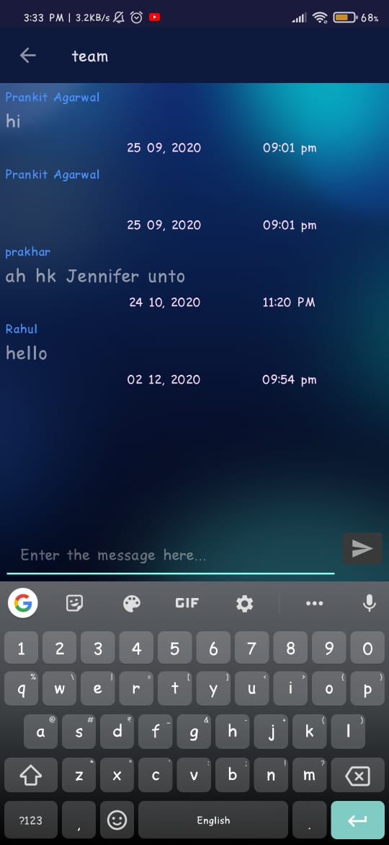
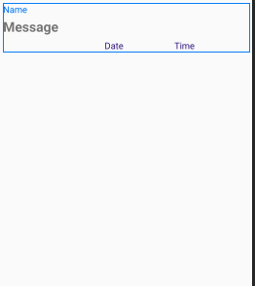
Prakhar
Group message view
message text
enter button
Group chat activity
Group chat

Slide 20
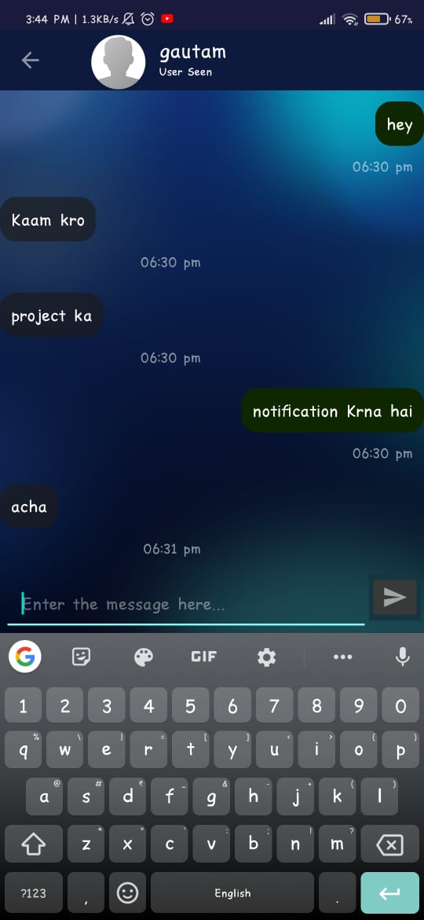
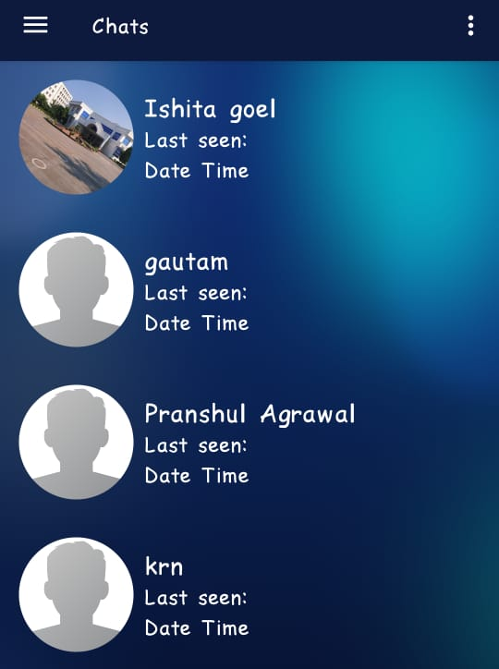
Aman
Personal Chat view
message text
enter button
Personal chat activity
Group chat

Slide 21
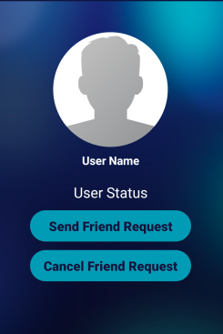
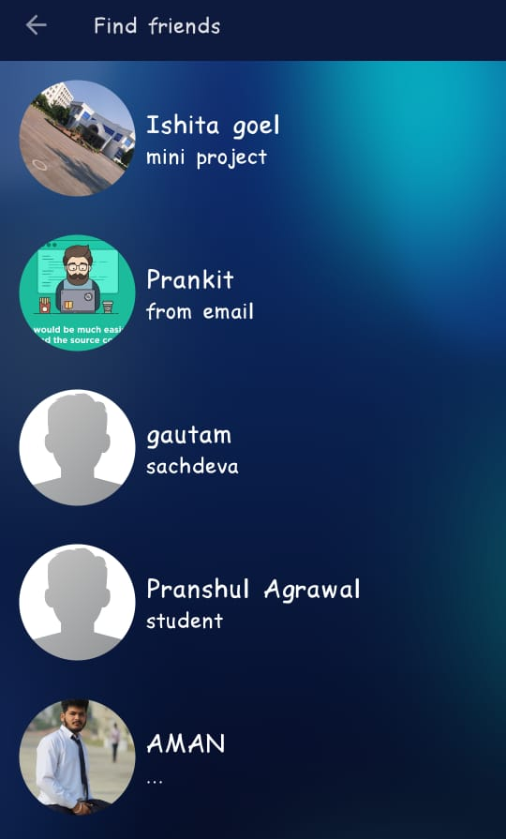
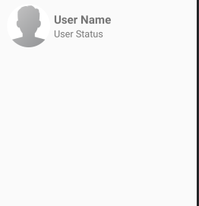
Rahul
User display view
User profile activity
All user activity
Friend request

Slide 22
CONCLUSION
Users first need to login via their contact number or email id.
Users have to upload their avatar or profile picture. (Not Mandatory)
Users can chat with multiple people at a time but that contact must be saved.
All the data is being stored in the database in the background.

Slide 23
THANK YOU

